Slide 1
Superstore Sales Performance Dashboard (2014–2017)
Data Analytics Internship – Week 4
Prepared by: Ebube Francis Okafor
Tools Used:
Microsoft Power BI
DAX
Microsoft Excel

Slide 2
Dataset Overview
Dataset
Superstore Sales Dataset
Description The dataset contains historical sales transactions from a retail superstore between 2014 and 2017.
Key Variables
Order Date
Sales
Profit
Customer Name
Category
Sub-Category
Region
State
Segment
Ship Mode
Objective
Analyze sales performance and identify business opportunities using interactive Power BI dashboards.

Slide 3
Business Questions
The dashboard was designed to answer the following questions:
What is the total revenue generated?
Which regions perform best?
Which product categories generate the highest sales?
Which customer segment contributes the most revenue?
Which products generate the highest profit?
How have sales changed over time?
Which states contribute most to sales?

Slide 4
Key Performance Indicators
These KPIs provide an overall snapshot of the company's financial performance.
KPI | Value
Total Sales | $2.30M
Total Orders | 5,009
Total Profit | $286.40K
Profit Margin | 12.47%

Slide 5
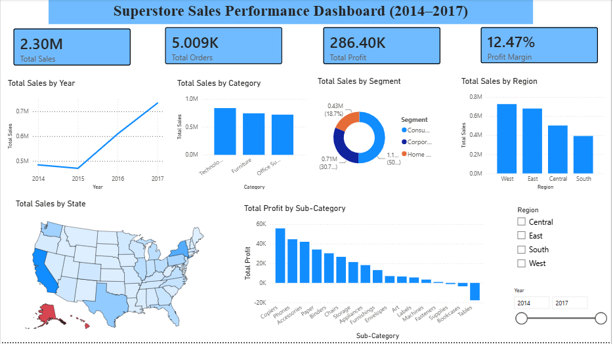
Dashboard Components

Slide 6
The dashboard includes:
KPI Cards
Sales Trend by Year
Sales by Category
Sales by Segment
Sales by Region
Sales by State Map
Profit by Sub-Category
Interactive Filters

Slide 7
Business Insights
Sales Trend
Sales increased steadily and reached their highest level in 2017.
Regional Performance
The West region generated the highest revenue.
The South region generated the lowest revenue.
Product Categories
Technology generated the highest sales.
Furniture ranked second.
Office Supplies ranked third.
Customer Segment
Consumer customers contributed over half of total sales.
Profitability
Copiers generated the highest profit.
Tables recorded a net loss.

Slide 8
Recommendations
Based on the analysis:
Increase investment in Technology products.
Improve marketing in the South region.
Investigate losses associated with the Tables sub-category.
Expand successful sales strategies used in the West region.
Focus customer retention efforts on the Consumer segment.
Monitor yearly sales trends to sustain business growth

Slide 9
Challenges Encountered
Learning DAX calculations.
Understanding the difference between Measures and Calculated Columns.
Working with date hierarchies.
Designing an interactive dashboard.
Formatting visuals professionally.
Skills Gained
Power BI dashboard development
DAX Measures
KPI Analysis
Interactive Reporting
Data Storytelling
Business Insight Generation

Slide 10
Conclusion
This dashboard successfully transformed raw transactional data into meaningful business insights that can support strategic decision-making and performance monitoring.

